Slide 1
Data Quest– Final round
Track 1 | Data wrangling and visualization
College/University | Manipal Academy For Higher Education
Software/tool used | Python, Streamlit Cloud, Qlik Sense
Student Name | Email ID | Course | Current semester/Year
Anusua Sen | anusua.psphmpl2022@learner.manipal.edu | M.Sc. Data Science | 2nd Year
Tess A Sebi | tess.psphmpl2022@learner.manipal.edu | M.Sc. Data Science | 2nd Year
Vanshikha Agarwal | vanshikha.psphmpl2022@learner.manipal.edu | M.Sc. Data Science | 2nd Year
Mentors- Ramya G Y, Vipin Gupta

Slide 2
Introduction
In this clinical trial, a comprehensive collection of information regarding subjects, their treatments, and observed adverse events has been documented. The datasets encompass a range of attributes, including demographic details, treatment specifics, and details of adverse events experienced by the subjects.
Each entry in the dataset pertains to an individual subject and is associated with a unique set of identifiers, such as "SITEID" and "USUBJID." The subjects are classified based on their treatment groups, denoted by "TRTA," and corresponding treatment annotations ("TRTAN"). Demographic information, including subjects' ages ("AGE"), racial background ("RACE"), and gender ("SEX"), provide context for the observed outcomes.
The datasets also catalog adverse events encountered by the subjects during the course of the trial. Adverse event descriptors ("AEDECOD") are provided along with their severity levels ("AESEV"). Furthermore, the datasets record specific dates relevant to treatment administration and adverse events, enabling temporal analysis.
This rich data serves as a valuable resource for investigating the interplay between treatments, demographic factors, and adverse events within the context of a clinical trial setting. Its comprehensive nature allows for exploratory and analytical studies aimed at understanding the relationships and patterns within the data.

Slide 3
Quest 1 – Demographic Discovery
Dataset used: ADSL
Columns considered: ARM, SEX, AGEGR1, ETHNIC, DCDECOD, COUNT
Software used: Python, Streamlit Cloud
Data description: The provided data describes participants in a clinical trial. It includes details like treatment arms (Arm A, B, or C), treatment start and end dates, participant demographics (age, gender, ethnicity), medical measurements (BMI, height, weight), education level, adverse events, and trial completion status.

Slide 4
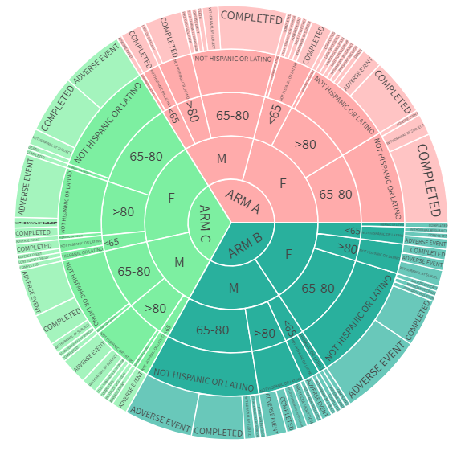
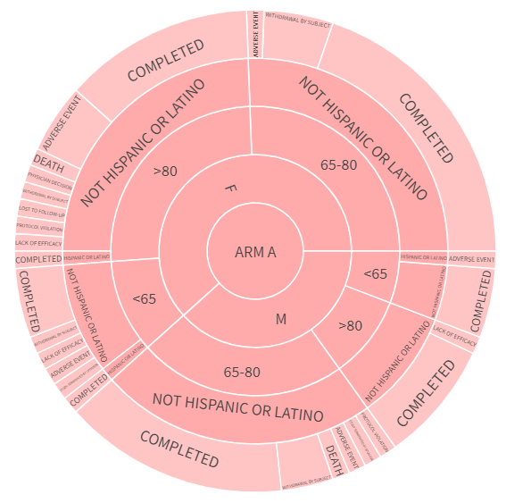
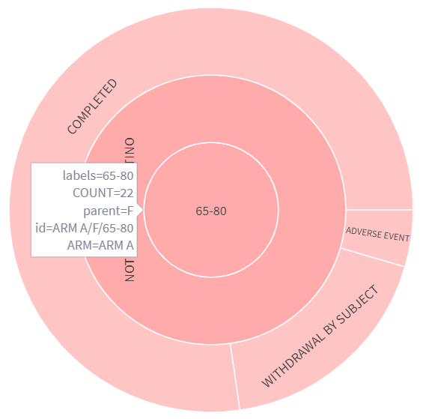
Visualization used:
A sunburst chart is used to reveal the age, gender, region, and disposition patterns across different treatment groups
It is an interactive hierarchical data visualization that displays data in a circular format, often resembling the sun's rays radiating outward.
It is primarily used to visualize hierarchical structures and their proportions at various levels.

Slide 5
Quest 2 – Interactive Lab (Chemistry & Haematology) Values Visualization
Dataset used: ADLBC, ADLBH
Columns considered: SUBJID, PARAM, AVAL, AVISIT
Software used: Python, Streamlit Cloud
Data description: ADLBC data covers blood chemistry parameters like Sodium, Potassium, etc., with actual, baseline, and change values. ADLBH data focuses on Haematological characteristics like Haemoglobin, Leukocytes, etc., providing actual values. Demographic info and flags for normal/high/low readings are included. The dataset tracks participant health changes over time.

Slide 6
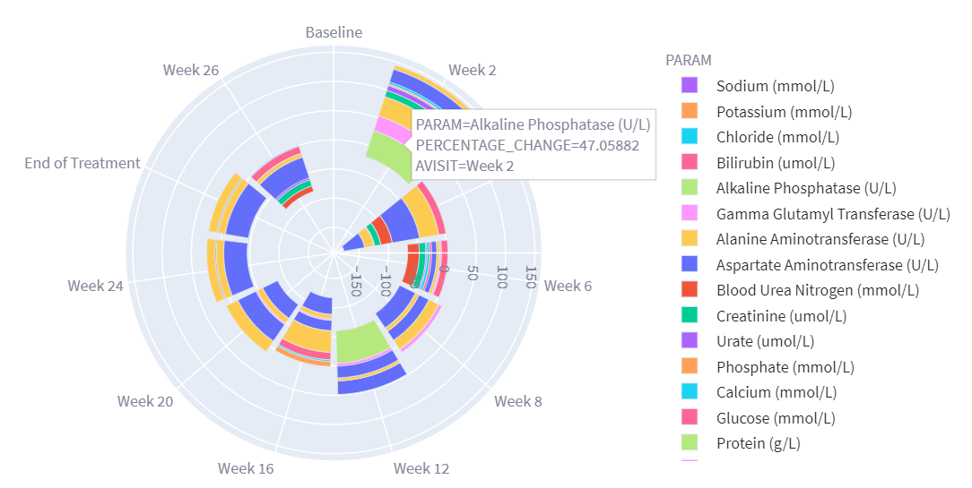
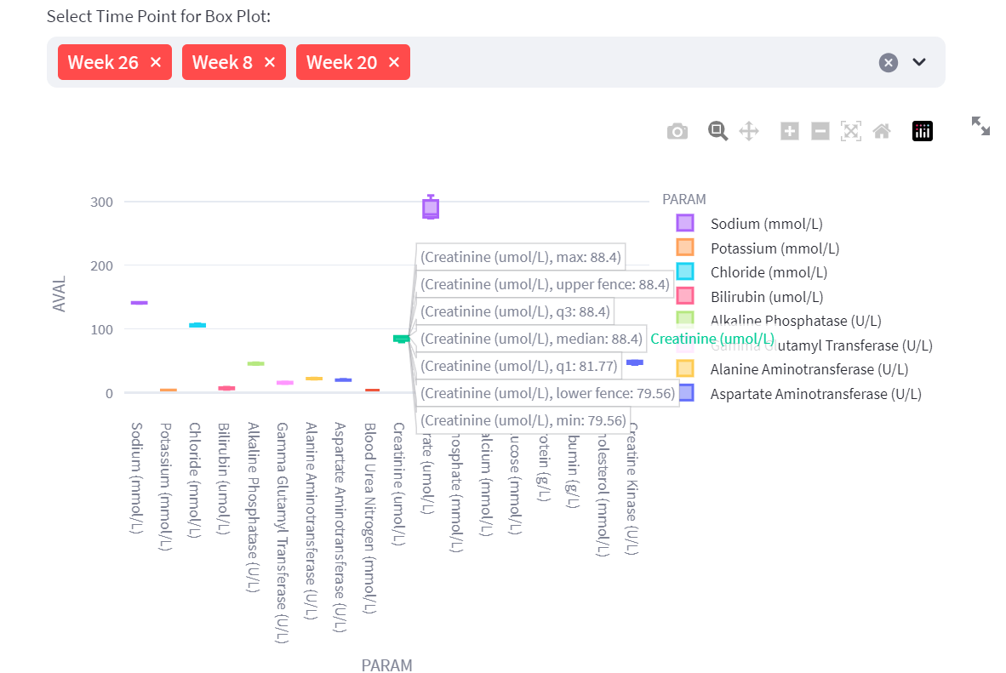
Visualizations used:
A polar stacked bar chart is used to compare changes from previous visits relative to normal range values using PCHG (percentage change) values for each subject.
It is a type of data visualization that combines the characteristics of a stacked bar chart and a polar (radial) chart.
Each stacked bar segment is represented as a sector within the circular chart. The stacks represent the parameters and they are plotted along the time points.
A box plot (also known as a box-and-whisker plot) is used to display a summary of the distribution of the parameters for all the subjects at each time point, providing insights into the spread, central tendency, and potential outliers within the data.

Slide 7
Quest 3 – Interactive Visualization of Adverse Events
Dataset used: ADAE
Columns considered: USUBJID, TRTA, AESOC, AEOUT, AESEV, AEDECOD
Software used: Python, Qlik Sense
Data description: The dataset provides information on adverse events experienced by participants in a clinical trial. It includes details like participant demographics, treatment information, age, race, sex, and adverse event characteristics. Each entry includes event descriptions, severity, outcome, recovery status, and various flags. The dataset helps track and analyze adverse events' occurrence and impact on participants over time.

Slide 8
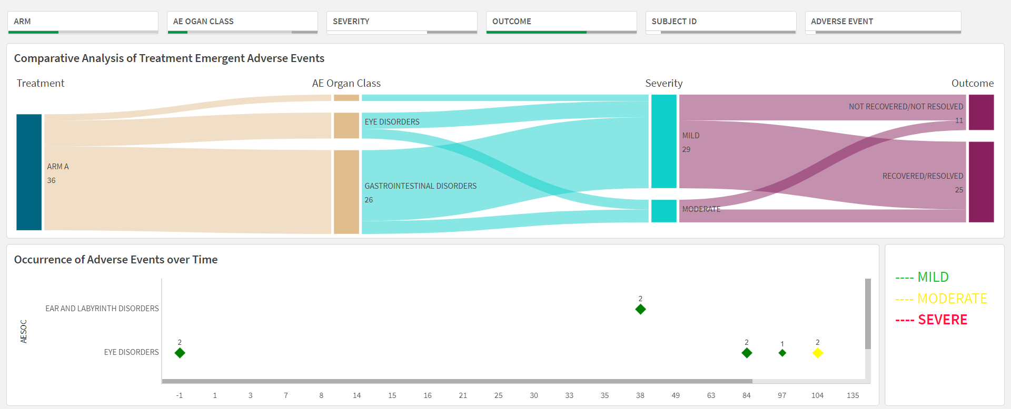
Visualizations used:
An interactive dashboard is created consisting of a Sankey plot and a Grid plot.
A Sankey plot, also known as a Sankey flow diagram is used for the comparative analysis of treatment emergent adverse events .
It is a visual representation that depicts the flow of quantities between different entities, stages, or categories. It uses connected arrows or lines of varying widths to show the proportion of the flow from one entity to another.
A grid plot is used for representation of adverse events occurrence over time.
It is used for organizing and displaying multiple visual elements or data plots in a structured grid pattern.

Slide 9
Quest 4 – Integrated Clinical Insights Dashboard Task
Dataset used: ADSL, ADAE, ADLBC, ADLBH
Columns considered: SUBJID, TRTA, SEX, AGEGR1, BMI_RANGE, DCDECOD, AESOC, AEOUT, AESEV, PARAM (ADLBC/ ADLBH), LBNRIND (ADLBC/ ADLBH)
Software used: Python, Qlik Sense

Slide 10
Visualizations used:
An Integrated Clinical Insights Dashboard is created comprising of a Pie chart, Stacked Bar chart, Donut Chart, Combo charts, and KPI (Key Performance Indicator).
The Pie chart displays the distribution and proportions of different Body Mass Index (BMI) categories.
The stacked bar chart represents the composition of Adverse Event Outcomes that are divided into segments. Each segment within a bar corresponds to a different category of outcomes (Recovered/Not Recovered/Fatal), and the height of the bar represents the total count of each category of severity.
The combo chart combines two or more different types of charts within a single plot. A bar chart is used to show the distribution of subjects across different time points for every parameter and at different levels of the parameters (normal/low/high/abnormal). A line chart is used to show the trend in data.
Donut charts are used to show the distribution and proportions of different levels of the parameters with interactive filters to explore every parameter.
KPIs are used to show the counts of subjects who had completed the study, faced adverse events, were lost to follow-up, or discontinued due to other reasons.

Slide 11
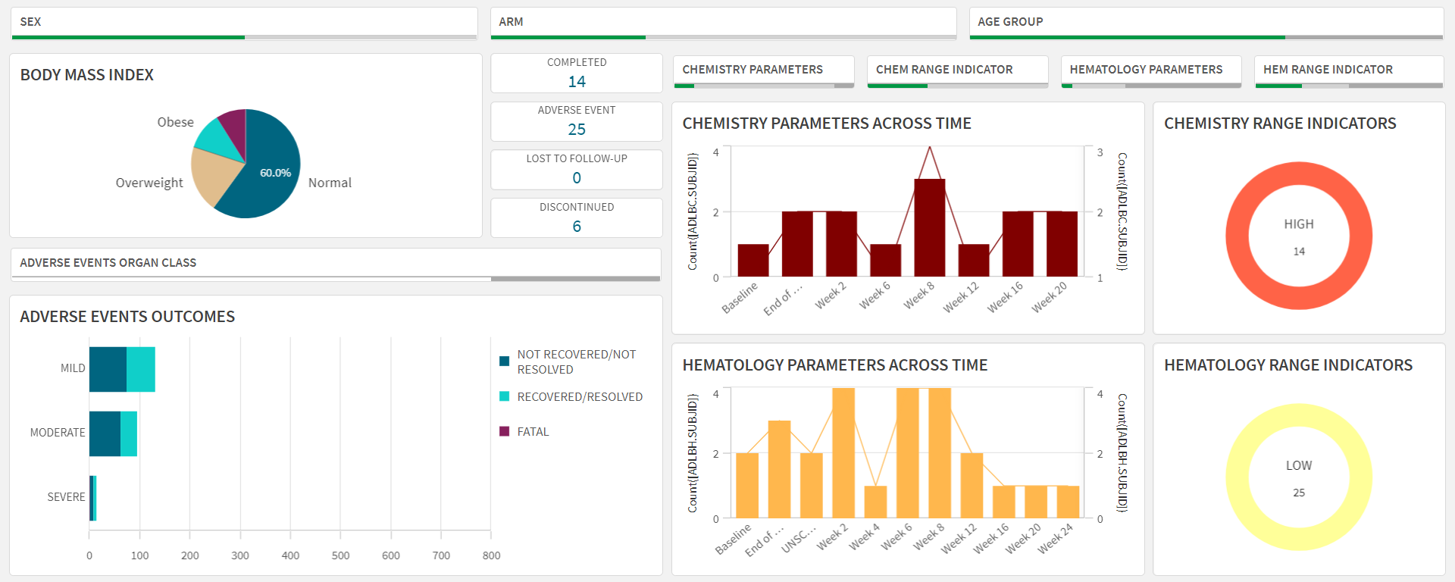
Visualizations used:

Slide 12
Conclusion
For the first objective, a Sunburst chart was employed to visually represent the hierarchical flow of data, effectively illustrating how various attributes such as treatment arm, gender, age group, and ethnicity interact within the dataset.
For the second objective, two types of data were available: Chemistry and Hematology. To understand the distribution of parameters for each subject across different time points, a Polar stacked bar chart and Box plots were employed.
Interactive filters used to explore end-of-treatment visit summaries revealed maximum, minimum, 1st quartile, median, 3rd quartile values along with outliers (if present).
For the third objective, two types of visualizations were utilized: a Sankey chart and a Grid chart.
Interactive filters used to get the summary of fatal adverse events and their outcomes showed that there were 3 fatal adverse events, two of them emerging from Arm A which were a severe Cardiac Disorder and a severe Psychiatric Disorder respectively and the third one emerging from Arm C which was a severe General Disorder and Administration Site Condition.
For the fourth objective, all the datasets were used to create an interactive clinical trial dashboard which provides a holistic view of the data exploring every combination of Arm, Sex, Age Group, and several other parameters.

